Slide 1


01
React Hook Form
Performant, flexible and extensible forms with easy-to-use validation.

Slide 2
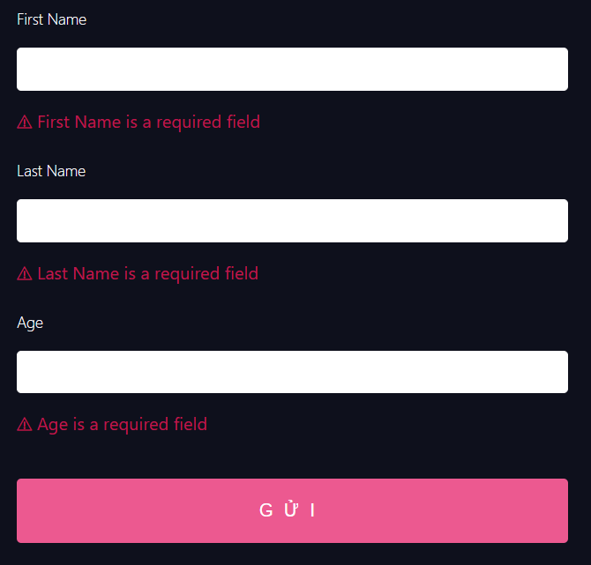
02
React hook form is a library that helps you validate forms in React

Slide 3
React Hook Form
Formik
Redux Form
Github start
22.3k
27.9k
12.6k
Created
2019
2017
2015
Component
uncontrolled & controlled
controlled
controlled
Rendering
minimum re-render
re-render according to local state changes as you type in the input.
re-render according to state management lib changes as you type in the input.
API
Hooks
Component (RenderProps, Form, Field) + Hooks
Component (RenderProps, Form, Field)
Package size
Small 8KB
Medium 15KB
Large 26.4KB
Validation
Built-in, Yup, Zod, Joi, Superstruct and build your own.
Build yourself or Yup
Build yourself or Plugins
Learning curve
Low to Medium
Medium
Medium

Slide 4
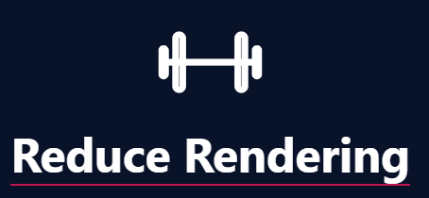
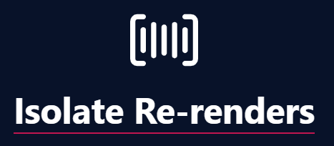



Why you should use React Hook Form

Slide 5
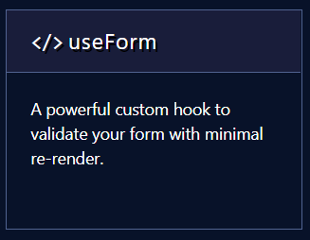
How to validate a form with useForm

Slide 6
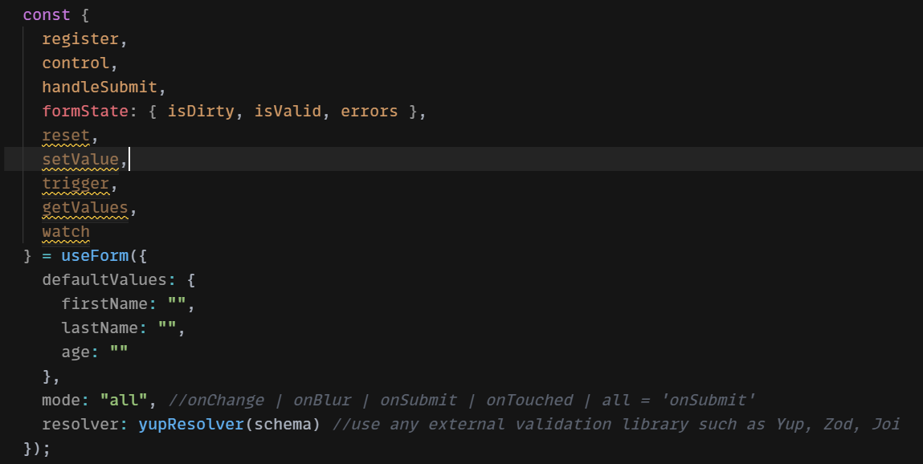
useForm()
useForm is custom hook for managing forms with ease

Slide 7
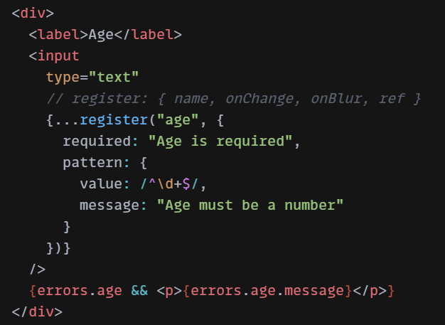
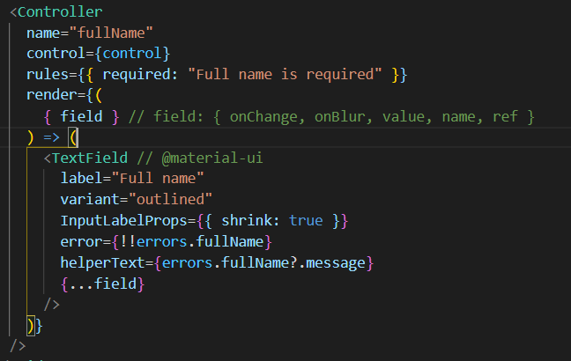
Register vs Control
Register an input or select element and apply validation rules to React Hook Form.
Wrapper component for controlled inputs will make it easier for you to work with React-Select, AntD and Material-UI.

Slide 8
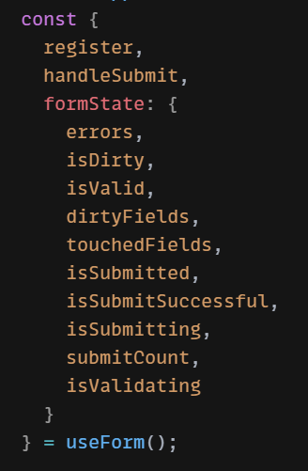
formState
State of the form :
- isDirty(boolean) : Set to true after the user modifies any of the inputs.
- isValid (boolean): Set to true if the form doesn't have any errors.
- errors (object): An object with field errors

Slide 9
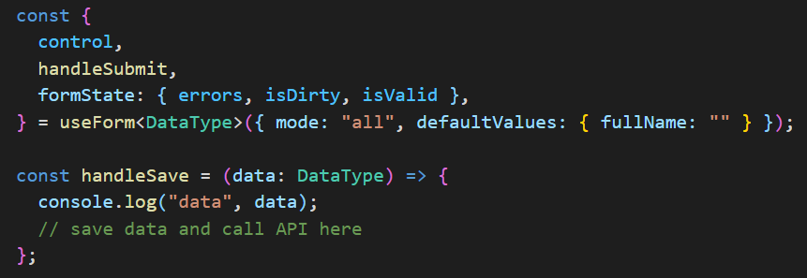
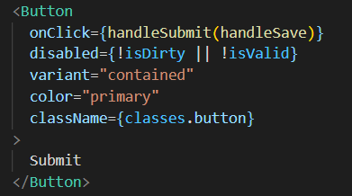
handleSubmit
Ready to send to the server
This function will received the form data if form validation is successful.

Slide 10
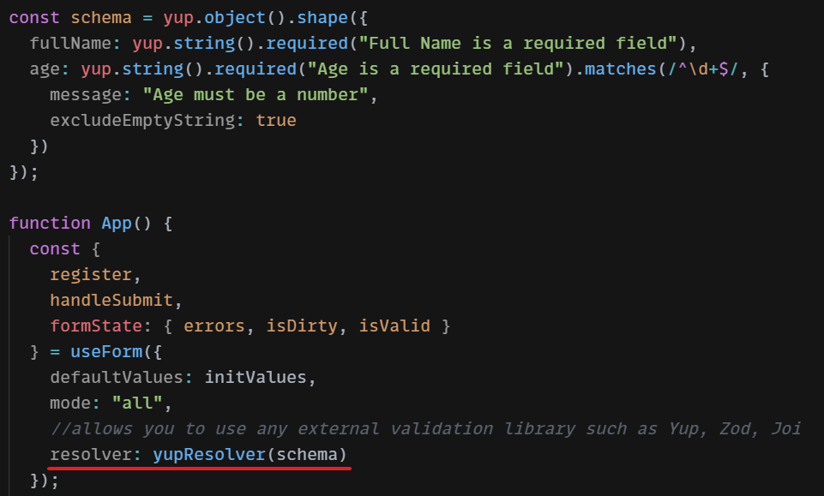
Resolvers
This function allows you to use any external validation library such as Yup, Zod, Joi, Superstruct, Vest and many others
npm install @hookform/resolvers

Slide 11
Other methods
- reset : reset either the entire form state or part of the form state.
- setValue : This function allows you to dynamically set the value of a registered field. At the same time, it tries to avoid unnecessary re-rerenders.
- trigger : Manually triggers form or input validation. This method is also useful when you have dependant validation
- watch : This will watch specified inputs and return their values. It is useful for determining what to render.
- useController, useFormContext, useWatch, useFormState, useFieldArray
....
https://react-hook-form.com/

Slide 12
Thank you !
Let me know if you have questions

